Slide 1
Indian Knowledge System-
An Introduction
Module-1

Slide 2
Do we need Indian Knowledge System?
IKS
is not about merely knowing about some ancestral
(पॖत॑क)
knowledge.
It is about protecting revised wisdom (ऺॠषख़ोधत ৯ॊन), economic security and national pride.
India has a long surviving civilizational history to at least 5000-8000 year back.
There is an impression that all knowledge that we benefit from has originated from west. (This is not true)

Slide 3
Do we need Indian Knowledge System?
Indians were extraordinary in steel making until the 17th century. The Indian ‘wootz’ steel was used to manufacture what was famously known as ‘Damascus blades’.
Due to major changes in the educational system in India introduced about 200 years back, there was a rather abrupt (आक्िक) end to the process of knowledge transmission.

Slide 4
Importance of Ancient Knowledge
Ancient (ঋॊचॎन) knowledge is the accrued knowledge over several generations and preserved in formal and informal means.
Formal means include documented knowledge and informal means include several values and practices through oral traditions.
Ancient knowledge provides a head start to
society to march on the
highway of innovation and new knowledge creation.

Slide 5
Importance of Ancient Knowledge
Importance of Ancient Knowledge--
➢Identity- It defines the context for several aspects of the day to day living of every individual.
➢Culture- It is the manifestation (अोभव्यस्तत) of human intellectual achievement regarded collectively by society over time.
➢Received Wisdom- Innovation and new knowledge creation for the society.
➢Economic Value- Transforming knowledge into economic values for the benefit of the country.

Slide 6
Defining Indian Knowledge System
IKS is generic phrase that covers practically everting about India.
We have recorded history, abundant (ो रपॐर) culture, literature and social and community practices defining what Indian knowledge.
Knowledge assets available in India from the pre-historic times to the current day will all qualify to be part of the IKS.
The term IKS has three words in it:
➢Indian
➢Knowledge
➢System

Slide 7
Defining Indian Knowledge System
➢Indian- By this term, we mean the indigenous sources of knowledge generated by Indian society. The term ‘Indian’ points to the undivided Indian subcontinent (Akhanda Bharata).
➢Knowledge- It is obtained by the insights gained by personal experiences with life situations, facing problems and coming up with means of solving them. Knowledge may or may not be converted to a literary format. The tacit knowledge can be preserved and transmitted through an oral tradition without loss.
➢System- Means a structured methodology and a classification scheme to access the available corpus (कख़ह) of knowledge.

Slide 8
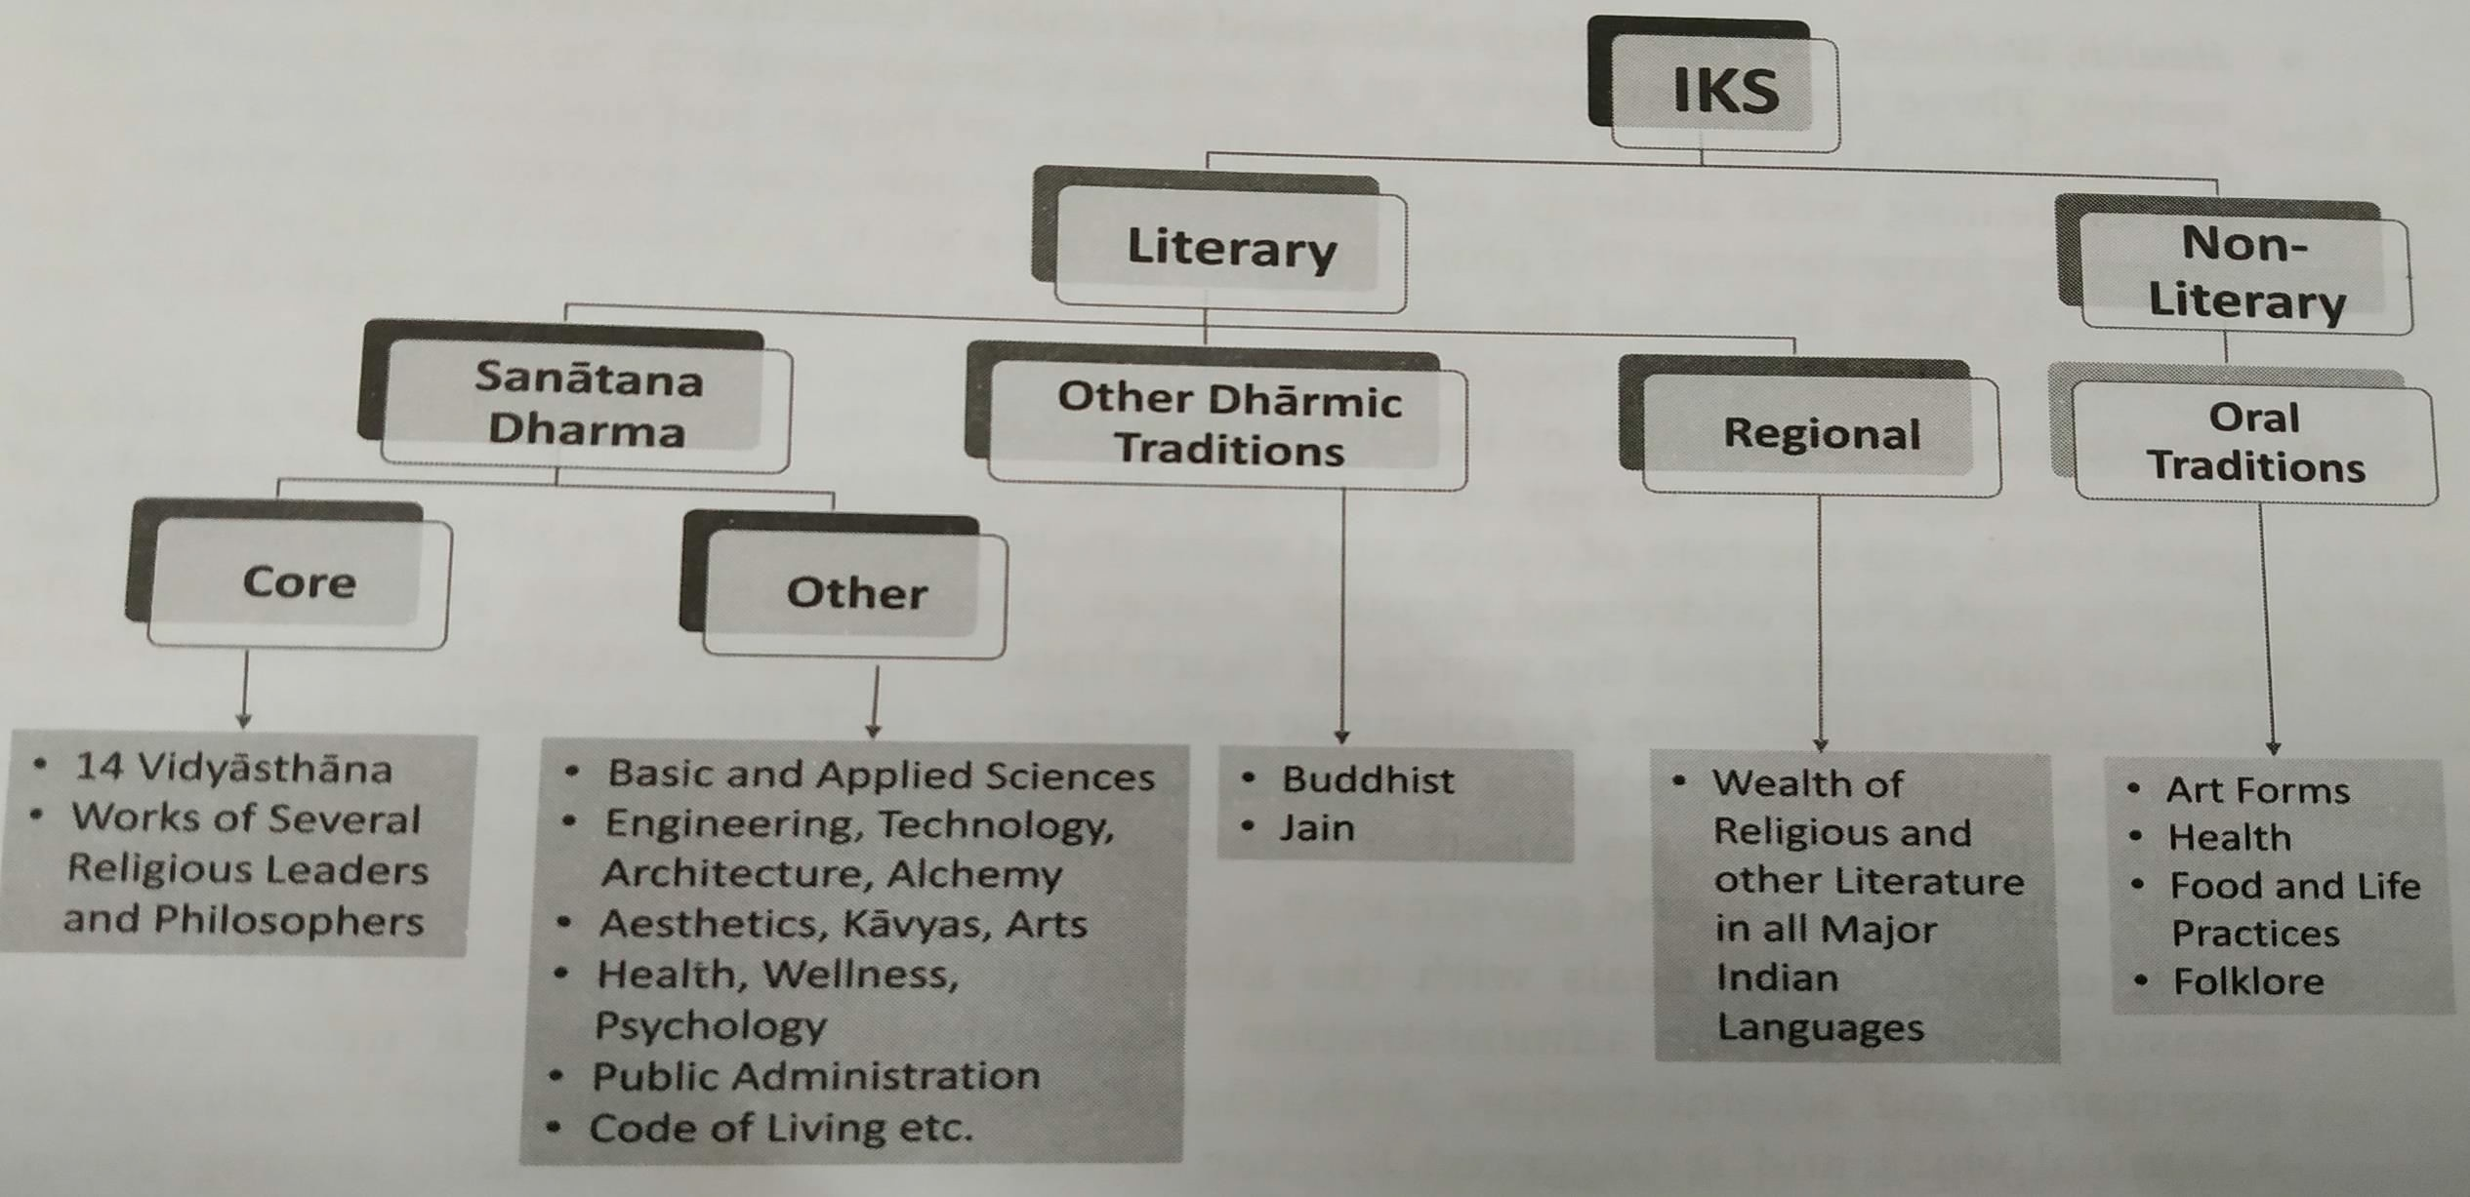
The IKS Corpus- A Classification Framework

Slide 9
The IKS Corpus- A Classification Framework
There are many ways to define and identify what constitutes IKS.
Ex:-
➢One approach to merely pick the important topics representatively of knowledge corpus such as Vedas, Yoga, Vastu, Silpa Sastras, Ayurveda, Buddhism and Jainism to define IKS.
➢Another approach is to select phrases such as Indian psychology, Indian arts, dance, architecture and put together related works into it to construct IKS.
➢NOTE:- These examples bring out the components of IKS.

Slide 10
The IKS Corpus- A Classification Framework
The usefulness of a classification framework depends on three factors: Completeness, Compactness and inter-connectedness.
➢Completeness assures that all important components of IKS are included in the proposed framework.
➢Compactness indicates the efficacy (ोঋॊश) of the grouping of various topics in IKS in logical manner.
➢Inter-connectedness brings logical relationship among the various sub- classifications.

Slide 11
The IKS Corpus- A Classification Framework
Closer scrutiny of IKS knowledge repository provides us following details:
➢The knowledge is available in both formal literary sources and informal literary source.
➢Among the literature sources, we can identify three categories
Vedic and allied literature
Other Dharmic Traditions
Regional
➢The non literary sources is available through a rich set of oral traditions found throughout the country.

Slide 12
Sanatana Dharma- Core Literature
➢This comprises a vast repository of knowledge starting with the Vedas, Known as Sruti.
➢Although the vedic corpus is oral in nature and still transmitted using oral methods.
➢The Vedas are considered foundational by the indian society.

Slide 13
Sanatana Dharma- Other Literature
➢The other literature consists of works that addressed key issues of day to day life such as health, wellness, science, engineering, technology that aided societal progress of development and art forms.
➢This category covers several areas:
Basic and Applied Science
Engineering, Technology & Architecture
Health, Wellness, Psychology
Public Administration
Code of living

Slide 14
Other Dharmic Traditions
➢Other dharmic traditions have stayed out of the Vedic framework but have immensely contributed to IKS in the religious, Philosophical and other domains.
➢Two of them, the Buddhist and the Jain literature are note worthy and they have contributed right from 500 BCE to IKS.

Slide 15
Regional Literature
➢The separation of regional language in this figure is only convenience.
➢Ideally, it could be included under sanatana dharma.
➢Indian constitution has listed 22 languages of the country, in each of these languages, there is a huge corpus of religious, philosophical and other literature.
➢Ex:- Tamil literature has several contributions in the Sangam Period.

Slide 16
Oral Traditions
➢The diversity of cultural practices and regional preferences have paved the way for oral traditions to preserve and transmit knowledge across generations.
➢These have been primarily in the form of folklore artistic endeavors, skillful jobs, foods and life practices and health.
➢Sanskrit has been dominant language for transacting knowledge for a long time in india.

Slide 17
Chaturdaśa-Vidyāsthāna
(चतॏद१ष-शशद्यॊमथॊन):
➢A classification framework for the sanatana-dharama
➢In this framework, the literature is systematically organized under 14 major divisions.
➢The components of the 14 part knowledge contain the four vedas (and their upa-vedas), the six vedangas, puranas, the Dharma- sastras, Nyaya.

Slide 18
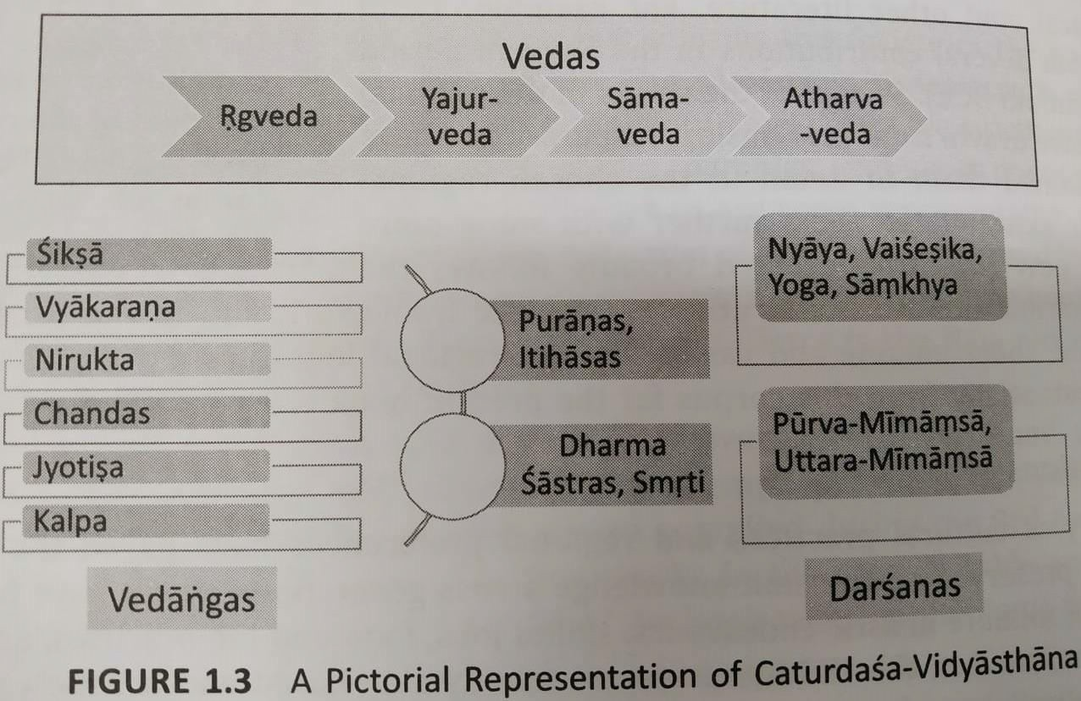
Chaturdaśa-Vidyāsthāna
(चतॏद१ष-शशद्यॊमथॊन):

Slide 19
Vedas
➢The Vedas are the primordial source of knowledge in the scheme of the Sanatan-dharma literature.
➢They are also known as Sruti.
➢Vedas provides the overall defining framework for living.
➢The upa-vedas are typically associated with the vedas on account of the material being found in the respective Vedas.

Slide 20
Vedangas
➢To benefits fully from the Vedas some complementary tools and skills are required.
➢These helps to understand the exact meaning an intent of what is presented in the Vedas and follow them based on specific instructions provided.
➢These are collectively referred to as Vedangas.

Slide 21
Darasanas
➢It is a natural quest for everyone to understand three forces that operate and intract with one another: an individual (Jiva), the Universe (Jagat), and a larger force governing the other two (variously referred to as Isvara, Brahman etc.)
➢Darsana essentially means a philosophical thought or view.
➢There are six schools of philosophy in the sanatan-dharma literature.

Slide 22
Puranas and Itihasas
➢Puranas contains a rich repository of ideas that seek to explain various aspects of the Vedic thoughts using detailed stories and anecdotes (उपॊূॊनख़).
➢They present several socio-cultural ideas and practices of living.
➢The stories in the purans related to per-historic events.
➢Itihasas, related to historical events that have taken place which can be associated with specific timelines.
➢As we know, Mahabharata and Ramayana are two well known itihasas.

Slide 23
Dharma-sastras and Smrtis
➢A guide to lead a dharmic life based on the principles of the Veda is required.
➢The dharmic principles engrained in the Vedic corpus are presented in multiple formats in our knowledge traditions.
➢Smrtis are rule books with specific operating guidelines of how to put the dharmic principles into action and what are the consequences of not doing so.

Slide 24
Historicity of IKS
➢Dating of the Indian Literature is a major challenge for today’s researchers.
➢Other related challenge is that most of the indian knowledge repositories in the BCE (Before Common Era or Before Current Era or Before Christian Era) were oral.
➢A useful source of data is to fix the Indian knowledge is the astronomical references found in the texts.

Slide 25
Before 3000 BCE
➢This era is categorized as the dark edge for western civilization since no evidence of any organized knowledge (either oral or written) is available.
➢Earlier estimates of time periods for Vedas, puranas and the Itihasas prove it be erroneous as new evidence and methods to date the knowledge becomes available.

Slide 26
3000 BCE to 500 CE
➢This period roughly starts with the beginning of recoreded human history as per the western context and extending as far as 500CE.
➢In an oral tradition, the entire knowledge is to be committed to one’s memory.
➢Therefore, it needs to be concise, and specific.

Slide 27
500 CE to 1800 CE
➢During this era, Indians have significant strides in the area of mathematics, astronomy, philosophy, spirituality.
➢Several contributions have also been made in other areas such as alchemy, metalworking etc.

Slide 28
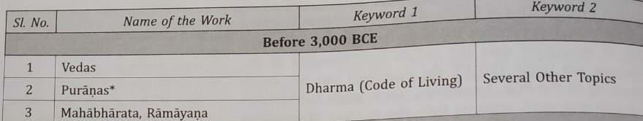
A Sample list of the IKS Repository

Slide 29
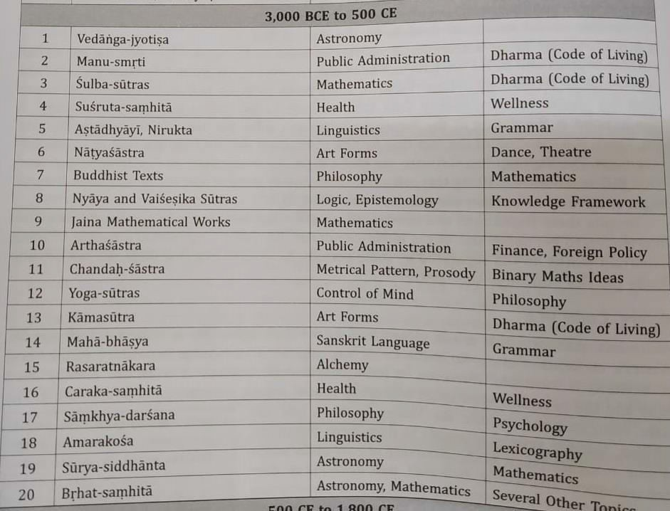
A Sample list of the IKS Repository

Slide 30
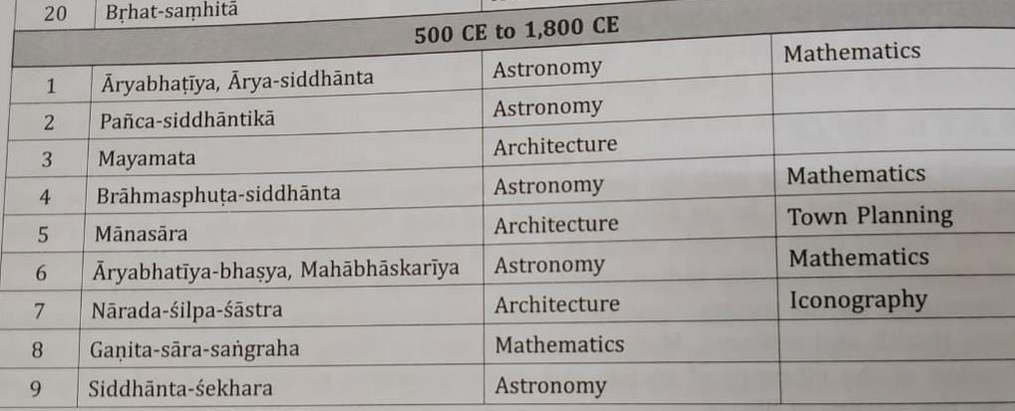
A Sample list of the IKS Repository

Slide 31
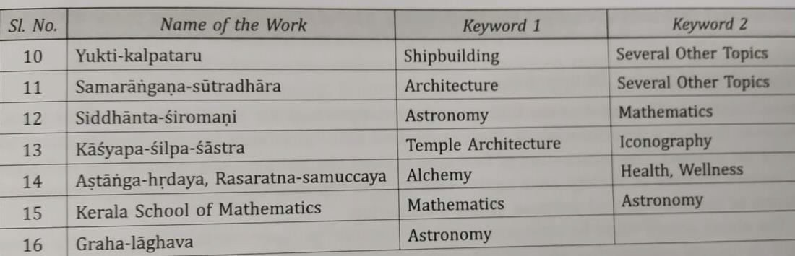
A Sample list of the IKS Repository

Slide 32
Some Unique aspects of IKS
Nuances (बारीकिय )ों of an Oral Tradition:
✓IKS is by and large oral tradition. If knowledge needs to be transmitted orally, it requires a few things.
✓In IKS a single work can provide simultaneously ideas on three streams: Spiritual, Religious and Secular.
✓A large number of works in IKS are in verses set to a metrical (षॊ४ष) structure irrespective of whether the subject matter is literature, mathematics, or engineering.
✓Two important dimensions of oral traditions are:
Religious Vs Material Dimension Spiritual Vs Material Dimension

Slide 33
Some Unique aspects of IKS
Typical Presentation Style- Sutras, Encryptions:
✓This is used irrespective of whether the work is original or a commentary on another work.
✓It is also independent of whether the subject matter is literature, mathematics, or engineering.
✓Several innovation methods are used to make the message concise and amenable (ऺॠो঴प्त और उत्तररढ़ ॊयॎ) to a metrical presentation.

Slide 34
VEDAS
The word Vedas is generally derived from the Sanskrit root vid.
The word Veda can be derived from five verbal roots, these means:
✓To exist
✓To discriminate
✓To obtain
✓To know
✓To make

Slide 35
VEDAS
Veda
is transmitted orally and preserved intact from time
immemorial.
Vedas have well-developed system of phonetics that has ensured its preservation.
Recognized by UNESCO as heritage.
It is well-known that the Vedas are the oldest surviving literary works in the whole world.

Slide 36
The four VEDAS
Ṛgveda
Yajurveda
Sāmaveda
Atharvaṇaveda

Slide 37
Ṛgveda
Ṛgveda is the oldest, largest and the main repository.
Ṛgveda should be studied by one who want to understand Indian Literature and spiritual culture.
Lofty
and interesting set of ideas found in Ṛgveda makes it
contextually relevant.

Slide 38
Yajurveda
Yajurveda mainly focus on Yajna and a list of various Yajnas are found in this Veda.
Yajurveda is in two major branches: Krsna (Black) -Yajurveda and Sukla (White) -Yajurveda.
Yajurveda include anatomy, metals, constellation, seasons, numbers and geometry, grains and yogic insights.

Slide 39
Sāmaveda
indicating ‘to please pacify or satisfy’, it refers to the singing of Rgveda mantras.
Sāmaveda has currently three branches: Kauthuma, Ranayaniya and Jaiminiya.
Sāmaveda is used to please the devatas by singing mantras after
making the offering.
The
word Sāmaveda is derived form the Sanskrit word Sama

Slide 40
Atharvaṇaveda
Atharvaṇaveda has details on diseases and their cure.
Paryers for prosperity and peace in the Vedas invariably included all the living organism in the Universe, not just the mankind.

Slide 41
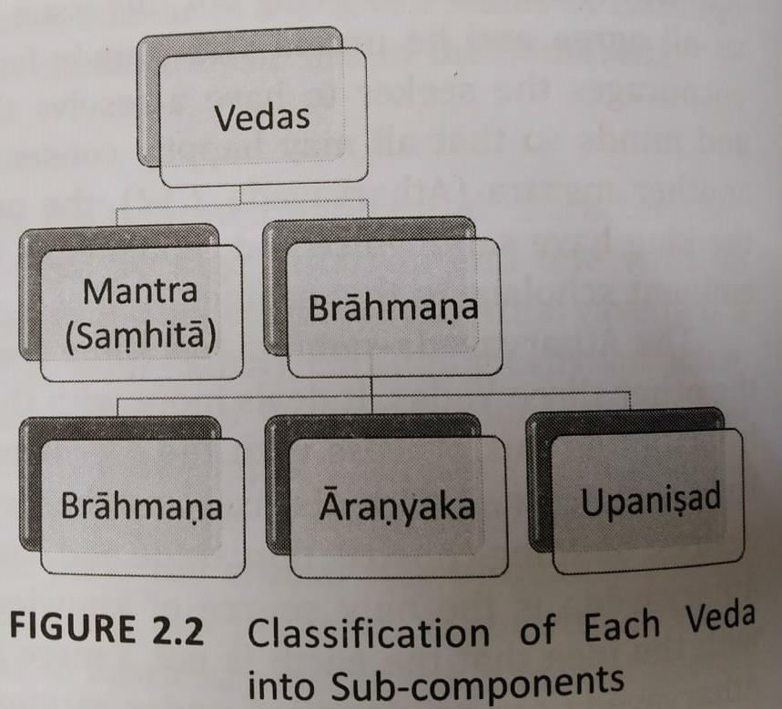
The Four Divisions of Each Veda

Slide 42
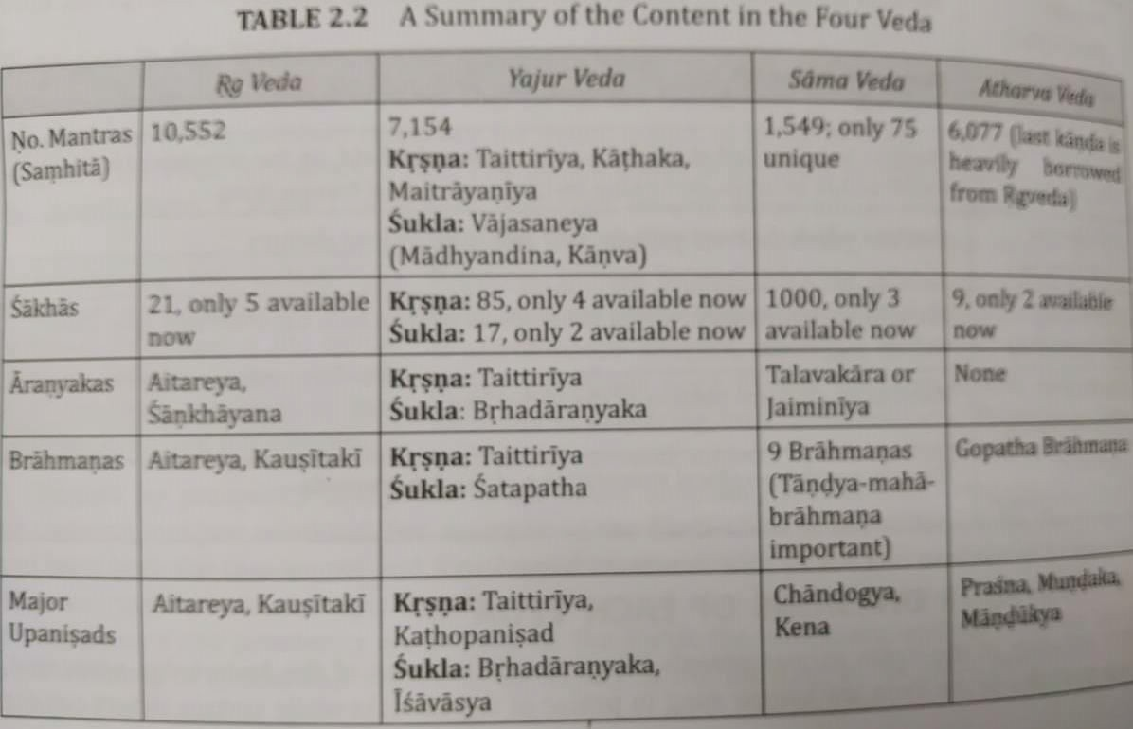
The Four Divisions of Each Veda

Slide 43
Samhita
Each Veda consists of Samhita, Brahmana, Aranyaka and Upanisads.
There were 25 women rishis who have composed hymns in Rgveda.
Samhita constitutes the main portion of each Vedas and cosist of a certain number of mantras presented in metrical form.

Slide 44
Brahmanas
Brahmanas does not relate to the modern word ‘Brahmin’, used to denote the caste.
These are a collection of knowledge mainly confined to the issue of ritual sand rites written in prose.
Brahmanas prescribe the mantras from the Samhitas that need to be recited for the rituals.

Slide 45
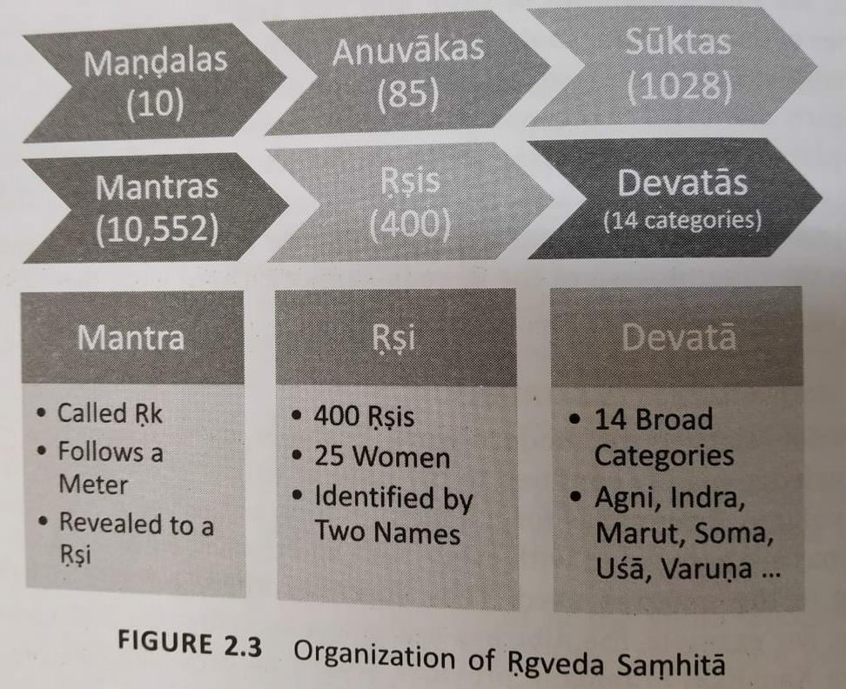
Brahmanas

Slide 46
Aranyakas
Aranyakas inquire into the philosophical aspect of a yajna.
Aranyakas are considered as bridge between brahmanas and Upanisads.
Aranyakas represent the Upasana kanda of the Vedas.

Slide 47
Upanisads
Upanisads
are philosophical treatises dealing with the ultimate
problems of life that every one of us confronts.
The word Upanisads means sitting near a Guru and receiving his wisdom through teaching-learning process.
Over 1180 Upanisads were supposed to have been part of the vedic corpus.
108 Upanisads in the four Vedas.

Slide 48
Upanisads
The loftiest thoughts of the vedic seers are found in Upanisads.
Upanisads pertains to the jnana-kanda of the vedas.
There are 10 principal upanisads.
The Maha-vakyas are found in the Upanisads.

Slide 49
Vedangas
Vedangas texts help us decipher the Vedic texts and know their practical applications; they have other values of practical applicability in other fields also.
There are six vedangas:
Siksa
Vyakarana
Chandas
Nirukta
Kalpa
Jyotisa

Slide 50
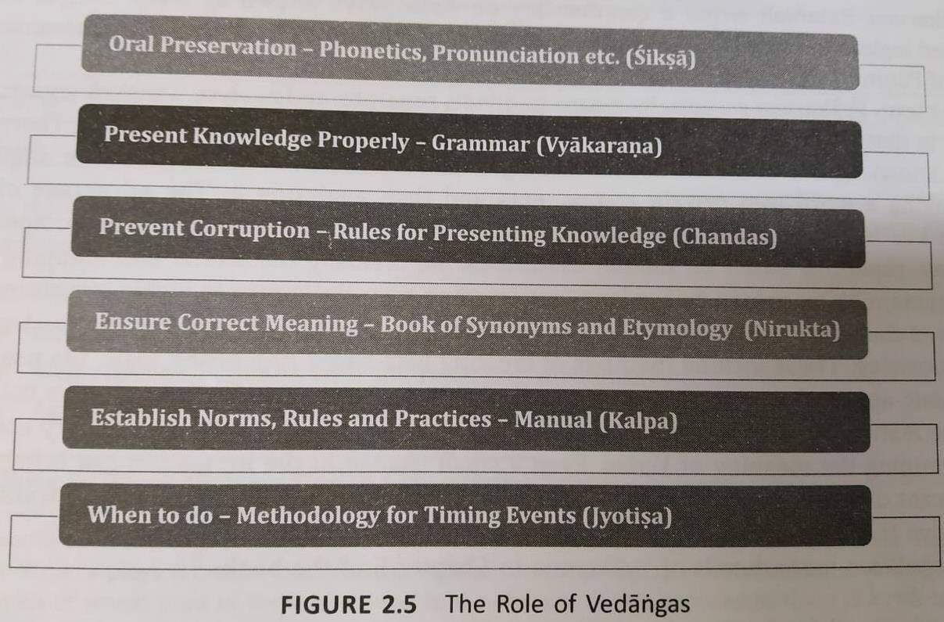
Vedangas

Slide 51
Siksa
The word Siksa means to acquire knowledge.
This has been described in Taittiriya Upanisad very briefly.
Siksa-sastra, therefore, is a systemic approach to the art and practice of phonetics.
It defines the characterstics of the basic units of the sound of the language known as varna.

Slide 52
Vyakarana
Grammar is the foundational aspect of any language.
TO understand the Vedic repository rules of grammar are required. Vyakarana is one the Vedangas that deals with this issue.
The
term Vyakarana essentially means to divide, separate and
analyze.

Slide 53
Nirukta
Nirukta is etymology, which is extracting the meaning of a word using linguistic theories and considering phonetic changes.
Nirukta is a collection of rarely used words in Vedas.
Nirukta is the most ancient work available on etymology anywhere in the world.

Slide 54
Chandas
Rhythm is the key aspect of an oral tradition be it Vedic mantras or music.
Chandas is the metre of poetic composition.
A Chandas (metre) can be viewed using three level hierarchy.
➢Syllables (aksara)
➢Padas
➢Metre

Slide 55
Kalpa
Kalpa focused on several operational aspects of the issues discussed in the Vedic Corpus.
Kalpa can be thought of as a guide or user manual that provides
aspects of life including
instructions and directions to lead all personal, family and social dimensions.
Following are the components of Kalpa:
➢Dharma-sutras
➢Grhya-sutras
➢Sulba-sutras
➢Srauta-sutras

Slide 56
Jyotisa
Like several other ancient civilizations, Indians were using the natural calendar which is based on keen observation of the sky with moon and stars.
This knowledge of the movement of stars and planetary bodies is called jyotisa.
Jyotisa-sastra is classified into vaidika (related to Vedas) and laukika (related to the world).

Slide 57
Philosophical Systems
The Philosophical systems provide a true worldview and a vision for life and helps us resolve the issues that we face in our life.
The
teaching of the Upanisads suggest that attainment of the
knowledge of Brahman is the highest goal of human life.

Slide 58
Indian Philosophical Systems- Development and Unique Features
The beginning of the Philosophical inquiry in India can be traced to the Vedic literature.
Unlike the western counterpart, the indian Philosophical thought closely intertwined with religious thought.
The ultimate goal of the human life is clearly spelt out and the path for attaining the same is also articulated in all the darsanas.
Two generic classes of philosophical systems could be thought about; Vedic schools of Philosophy and non-vedic schools (Jaina Philosophy, Buddhist Philosophy etc).

Slide 59
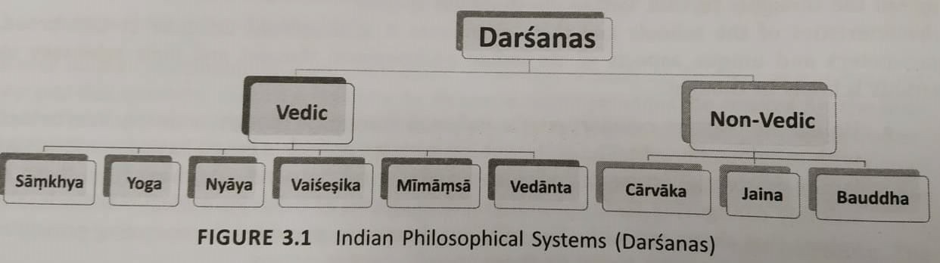
Indian Philosophical and Unique Features
Systems- Development

Slide 60
Vedic Schools of Philosophy
Vedic schools acknowledge the authority of the Vedic text whereas Non-Vedic schools do not.
The
context for philosophical discussion is three inter-related
concepts of God-Universe-Individuals.

Slide 61
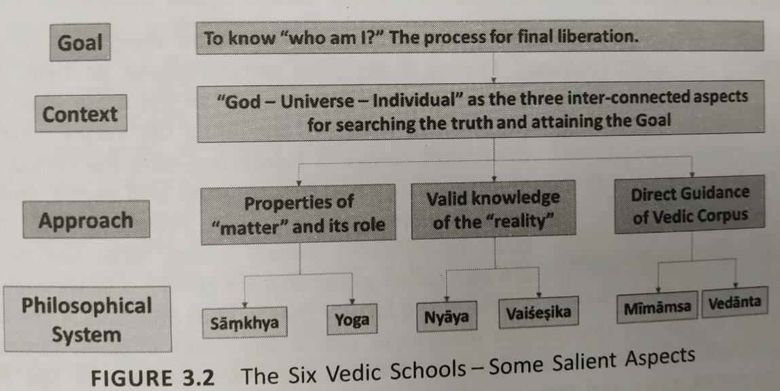
Vedic Schools of Philosophy

Slide 62
Samkhya and Yoga schools of Philosophy
Samkhya-darsana- Purusa and Prakrti
Yoga-darsana
Purusa and Prakrti- According to the Samkhya system, two basic elements constitute everything in this world, matter (Prakriti) and sprit (Purusa). Prakriti is made of three basic constituents namly sattva, rajas, and tamas.

Slide 63
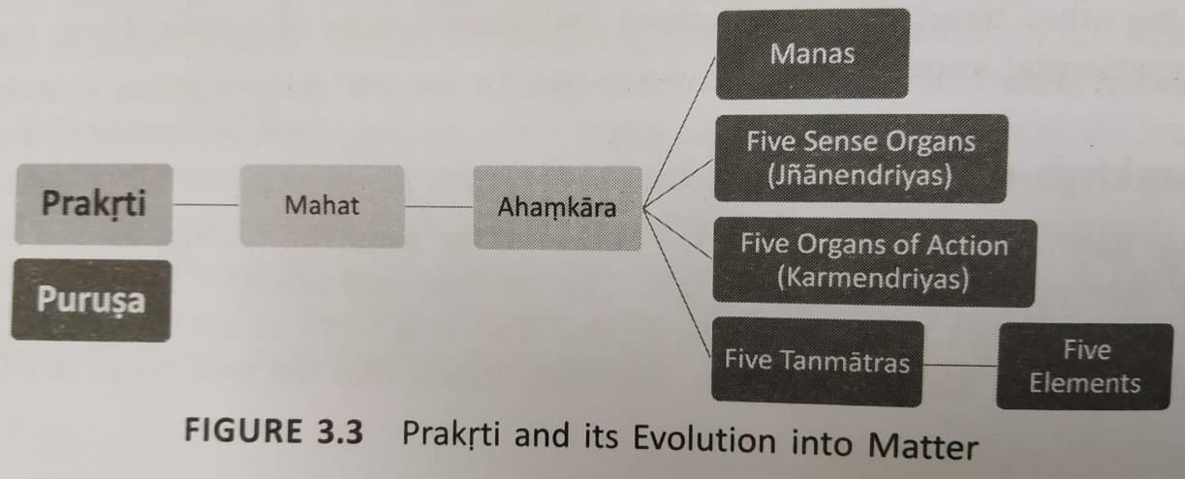
Purusa and Prakrti

Slide 64
Yoga-darsana
Yoga as a school of philosophy is said to have been founded by Patanjali through his Yoga-sutras.
According to Yoga Philosophy to attain liberation, an individual must focus on the physical, psychological and moral states of his being.

Slide 65
Yoga-darsana
Yoga provides a structured and practical eight-step process gradually reach a stage of complete cession of the activities of Citta.
Yoga can help an individual address the vexing problem of stress- induced lifestyle leading to health and wellness challenges that modern society is facing.

Slide 66
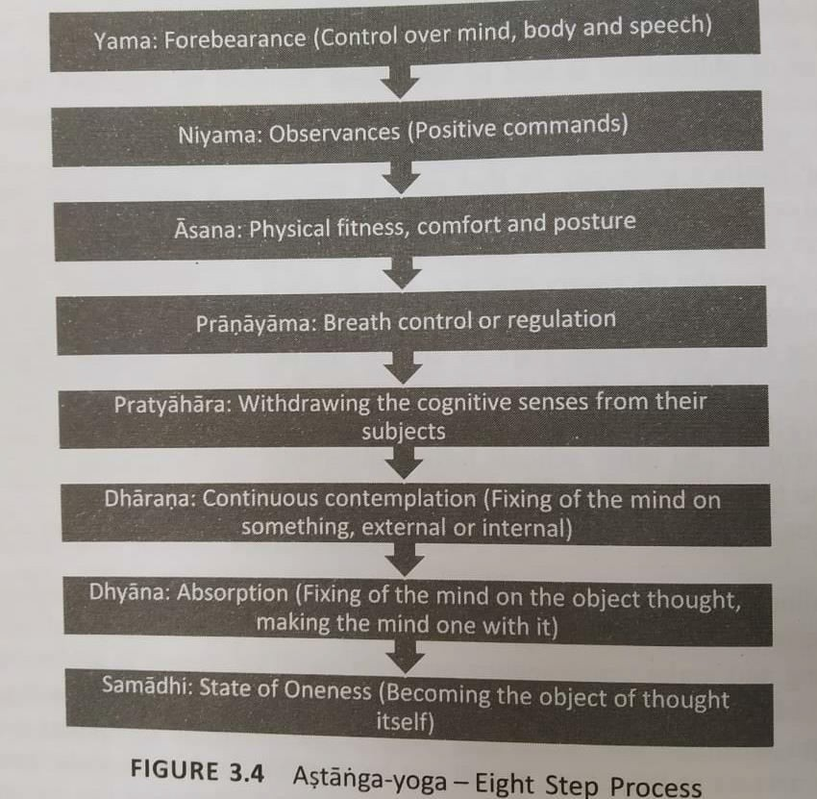
Yoga-darsana

Slide 67
Nyaya and Vaisesika schools of Philosophy
Nyaya deals with ‘ways of knowing the reality’ and Vaisesika with
‘objects in the reality that knowable’.
Nyaya and Vaisesika schools place a greater emphasis on obtaining the right knowledge for liberation.
The
word Vaisesika is derived from the word Visesa meaning
difference or unique attributes in a thing.
The Vaisesika school presents the knowable that form all the real entites in the universe using certain categories.

Slide 68
Nyaya and Vaisesika schools of Philosophy
Categories of Nyaya and Vaisesika schools of Philosophy:
Nyaya-darsana
Vaisesika-darsan

Slide 69
Purva- Mimamsa and Vedanta schools of Philosophy
This portion typically referred to as Karama Kanda of the Vadic Corpus.
Both the schools share common beliefs in several of the philosophical principles.
This includes the notation of atman, the existence of karma, rebirth and long seemingly endless cycle of birth-death.

Slide 70
Purva- Mimamsa Darsana
The
word Mimamsa conveys different meanings: reflection,
consideration, profound thoughts, investigation, examination and discussion.
In the context of Purva- Mimamsa schools Mimamsa Means refelection or critical investigation.
Purva – Mimamsa school has established its tenets based on the karma kand.
The Purva- Mimamsa text provides rules for the interpretation of the Vedas and Provide philosophical justifications for the observance of Vedic rituals.

Slide 71
Vedanta (Uttara- mimamsa darsana)
The Vedanta school has established its tenets based on Jnana Kanda.
The Vedanta school rely on three major texts known as Prasthana- traya for establish their tenets.
This includes the Brahma-sutras written by Badrayana (Vyasa).
Following are the aspects of schools of Vedantas:
➢Advaita- Vedanta (reconizing what is one’s inherent nature)
➢Visistadvaita- Vedanta (combines the bhakti to the personal God and impersonal God as espoused in the Upanisads into a single school of thought)
➢Dvaita- Vedanta (that Visnu is the supreme God, the world is real and there is a difference between God and the Jivas.

Slide 72
Non- Vedic Philosophical Systems
Jaina School of Philosophy
Buddha School of Philosophy
Carvaka School

Slide 73
Jaina School of Philosophy
The word Jaina is derived from the Sanskrit root “ji” to conquer essentially indicating someone who has successfully subdued his passions and obtained mastery.
In this, the cycle of birth-death is attributed tiny particles of matter that have embedded themselves into Jiva; this is called karma.
In the Jain philosophy, spiritual growth is to overcome this karma.

Slide 74
Buddha School of Philosophy
The Buddha School of Philosophy is largely based on the teaching of Gautama Buddha.
There are two forms of Buddhism: the northern form and the southern form.
Buddha’s philosophy focuses on the means of ending the suffering of the inviduals.
The four noble truths of Buddhism are:
  Suffering by clinging to 5 aggregates
  Thirst causes rebirth and suffering
  Cessation of suffering by destruction of desire
  8-fold path to end the suffering

Slide 75
Carvaka School
Carvaka School of thought closely maps to the trait of materialism which emphasizes a life of enjoyment based on certain principles and assumptions about life.
According to Carvaka school whatever is directly perceivable can only be accepted as valid means of knowledge.
No text of the Carvaka school is available to us today which discusses its tenets in totality.

Slide 76
Features of Carvaka School
Matter is ultimate reality
World is made of four basic elements
No room for any of the transcendental entities
No afterlife, rebirth
Conclusions and knowledge are embodied, not eternal
Goal of life is experience pleasure ‘here and now’

Slide 77
Wisdom through the Ages
Stories provide a powerful medium through which one can impart education on a wide range of topics.
The genesis of this text provides interesting insights into the power of storytelling in bringing the accumulated wisdom to use.

Slide 78
Puranas- An Encyclopedic Work
Puranas are one of the most important literary sources of ancient and medieval Indian history and culture.
Puranas are companion texts to help understand and interpret the Vedas.
The study of Puranas and the Upapuranas are critical to developing an understanding of the social and religious institutions of India.
Puranas deals with the evolution of the universe, the recreation of the universe, genealogies of Gods and seers (रढ़ ॕ शतॊओॠ और ঈष्टॊओॠ कॎशॠषॊशलॎ), and history of royal families.

Slide 79
Categories of Puranas
Maha- puranas
➢18 in number, about 400,00 verses
➢Cover a wide varity of topics
➢Has five laksanas
Upa- puranas
➢Several available
➢18 indentified as prominent
➢Smaller than Maha-Puranas
Sthala- puranas
➢Several of them available
➢Regioanl focus
➢All Languages (mainly in Sanskrit)

Slide 80
Contents/ Characteristics of the Puranas
There are five Characteristics of Puranas known as panca-laksanas.
Sarga (Creation of the Universe)
Prati-Sarga (Destruction and re-creation)
Vamsa (Dynasties (रॊजशॠषख़)ॠ of Kings)
Manvantara (Times of different Manus)
Vamsanucarita (Stories of the Dynasties)

Slide 81
Issues of Interest in the Puranas
Puranas contain several discussions related to the plant kingdom and its role in addressing food, medicine and other requirements of society.
Several Puranas have discussions on astronomy, which consists of ideas in the pre-telescope age.
Issues of Interest:
  Food and Medicine
  Foetal Development: Stages of Growth
  Astronomy
  Geography

Slide 82
Itihasa as a source of Wisdom
The etymology of the word Itihasa provides us some clues about the nature of the work and its content.
The word Itihasa points to history.
The text which teaches the four goals of life Dharma, Artha, Kama and Moksa and which deals with stories of historical happenings is called Itihasa.
According to Kautiyla- history (Purana, Itivrtta), tales (Akhyayika), illustrative stories (Udaharana), Dharmasastra and Arthasastra are known by the name Itihasa.

Slide 83
Uniqueness of the two Epics
The two Itihasa Ramayana and Mahabharata occupy a very unique position in the repository of the Indian Knowledge System.
Itihasa is stories related to some past events viewed through the lens of four purusarthas.
Ramayana and Mahabharata are two encyclopedias of the ancient Aryan life and Wisdom, Portraying and ideal civilization.

Slide 84
Uniqueness of the two Epics
Ramayana takes a normative approach while Mahabharata takes descriptive approach to present events and decisions.
Indian drama, dance and other performing arts have been greatly influenced by the wo epics.

Slide 85
Ramayana- Key Issues and Messages
Ramayana consists of seven books which are called as Kandas, organized into 654 sargas (chapters) and 23672 verses.
Ramayana is a vast history of Rama but also consist of many other related instances.
In India, more than 40 versions of Ramayana in different languages like the Ramcaritmanas in Avadhi, Kamba-Ramayana in Tamil. Madhava-Kandali in Assamese, Gona Budha’s Ranganatha-Ramayana in Telugu, Jagamohan- Ramayana in Oriya, Narahari-Ramayana in Kannada, etc.

Slide 86
Ramayana- Key Issues and Messages
Ramayana
has played a significant role in cultural transmission
between Indian and other Asian countries.
According to Ramayana, Rama is not merely a human being but an embodiment and a living entity of the concept of Dharma.
Ramayana
provides a rich opportunity to understand important
aspects of peaceful; co-existence and successful living.

Slide 87
Ramayana- Kandas
Ramayan encourages one to contemplate the difference between
‘goodness’ and ‘greatness’ and the need to have both to succeed in life.
Bala-Kanda
Ayodhya-Kanda
Aranya-Kanda
Kiskindha-Kanda
Sundera-Kand
Yuddha-Kand
Uttara-Kand

Slide 88
Mahabharata- A Sourcebook For Worldly Wisdom
Mahabharata is one of the greatest poems in the world composed by Krsna - Dvaipayana (Veda Vyasa).
Mahabharata discuss a verity of topics including law, philosophy, religion and custom.
Mahabharata presents the reality of life and allows the reader to pick up their lessons for living.
Nitis are the guidance to take a person to the path on Dharma by providing the right perspectives about life and goals.

Slide 89
Mahabharata- Issues Discussed in the Text
Birth, Childhood and Rivarly
Banishing of Pandavas
Failed peace parleys leading to war
Post-war conversation between Yudhisthira and Bhisma
The exit of the character

Slide 90
Mahabharata
1,00,000 verses, over 2,000 chapters
Descriptive approach- characters present the reality of life
Rich collection of deeply nested stories
Many nuggets of wisdom- Yaksa Prasna, Vidhur Niti, Sanat- sujatiya, Bhagavad Gita

Slide 91
Niti-Sastras- Collection of Snippets of Wisdom
Nitis are the guidelines to take a person to the path of Dharma by providing the right perspectives about life and life goals.
The role of Niti- sastras lies in providing us helpful direction from past experiences.
Niti
texts take into consideration the very basic rules that all
purusarthas are generally guaranteed to the individuals by the universe.

Slide 92
Niti-Sastras (Some Selected Niti Texts)
Barhaspatyam
Vidura-Niti (Part of Mahabarata)
Pancatantra (Visnu Samra)
Hitopadesa (Narayana Pandita)
Niti- sataka (Bartrhari)

Slide 93
Subhasitas- A Collection of Insights From Various Texts
The concise poetry which communicates the valuable message for the society with some interesting examples is called Subhasitas.
These
are nothing but a systematic collection of insightful
observations, examples and principles of life from a wide range of existing repositories of literary work.
Collection of ideas from various texts comes from certain traditions of the great Indian poets.
https://www.youtube.com/watch?v=HFfzrfufOCw

